Slide 1

Aspiring Mind Employment Outcomes
Exploratory Data Analysis
-- Dinesh Dasaroju

Slide 2

About me
Hello! I am Dinesh, a B.Sc. Life Science graduate from Osmania University. Despite pursuing a non-technical field during my college days, my curiosity about programming and emerging technologies such as AI and Robotics was insatiable. This curiosity eventually led me towards Data Science, a field I found immensely intriguing.
What captivated me about Data Science is its vast diversity, spanning across various sectors including Finance, Healthcare, Manufacturing, Education, and both Government and Private sectors. This diversity underscores the wide applicability and demand for data-driven insights in today's world.
Motivated by this realization, I made the decision to transition from Life Science to Data Science. Now, I am thrilled to present to you some insightful slides regarding my project on Aspiring Mind Employment Outcomes Data.
LinkedIn

Slide 3
Introduction
India produces 1.5 million engineers every year. A relevant question is what determines the jobs and salaries these engineers are offered right after graduation.
Some studies have shown the influence of various factors such as college reputation, grades, the field one specializes in and market conditions for specific industries.
An important input which such analyses do not have is a standardized measures of job skills done at the time of completion of studies. We present here Aspiring Minds' Employability Outcomes 2015 (AMEO 2015), a unique dataset which provides engineering graduates' employment outcomes (salaries, job titles and job locations) together with standardized assessment scores in three fundamental areas - cognitive skills, technical skills and personality.
Coupled with biodata information, AMEO 2015 provides an opportunity for a unique and comprehensive study of the job market. The data could be used to make an accurate salary predictor, but also understand what influences salary and job titles.

Slide 4
Objective of the Project
The primary objective of this project is to gain comprehensive insights and factual data regarding job opportunities offered to engineering students immediately following their graduation. Specifically, the project aims to address several key questions:
Salary Negotiations: Explore and analyze the salary negotiations undertaken by engineering graduates upon completion of their studies. This involves understanding the average salary ranges, factors influencing negotiation outcomes, and trends in salary offers across different engineering disciplines.
Gender Bias in Salary: Investigate any potential gender biases in salary offers to engineering graduates. This entails examining whether there are disparities in salaries between male and female graduates within similar roles and fields of study.
Field of Study Disparities: Explore whether there are variations in pay scales based on the specific engineering field of study. This involves comparing salary data across different disciplines such as information technology, civil engineering, mechanical engineering, etc.
To achieve these objectives, the project will employ advanced analytical techniques such as Exploratory Data Analysis (EDA) and sophisticated visualizations.

Slide 5
Data Description
The dataset was released by Aspiring Minds from the Aspiring Mind Employment Outcome 2015 (AMEO). The study is primarily limited only to students with engineering disciplines.
The dataset contains various information about a set of engineering candidates and their employment outcomes. Profile Information includes:
Scores on Aspiring Minds’ AMCAT – a standardized test of job skills. The test includes cognitive, domain and personality assessments
Personal information like gender, date of birth, etc.
Pre-university information like high school grades, etc.
University information like study year, GPA, etc.
Employment Outcome Information like First job annual salary, Job title, etc.

Slide 6
Exploratory Data Analysis
Data Manipulation
Univariate Analysis
Bivariate Analysis

Slide 7
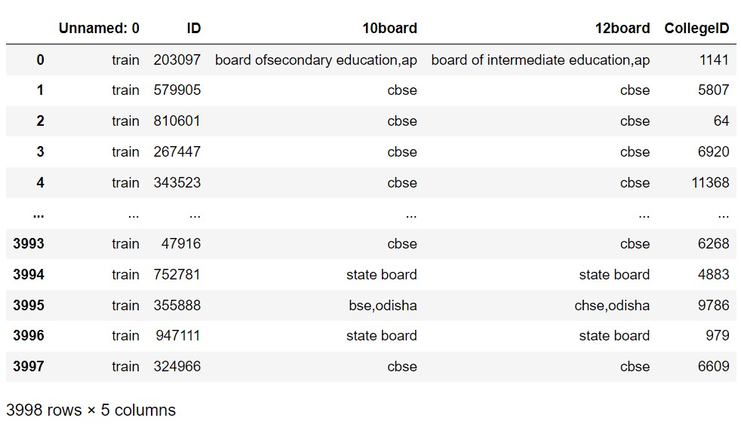

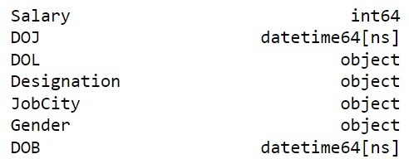
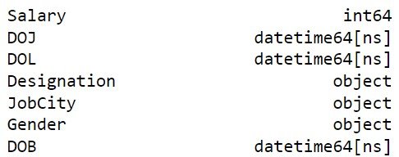
Data Manipulation
In the Dataset I found some columns like : Unnamed: 0,ID,10board,12board,Clg ID. which are not important so I have dropped this columns.
In one particular column named “Date of leaving the job”. I found some records representing as “present”. So I assumed that they actually left the Job in the year 2015. So I have replaced “present” with a date and type casted the column to Data time format

Slide 8
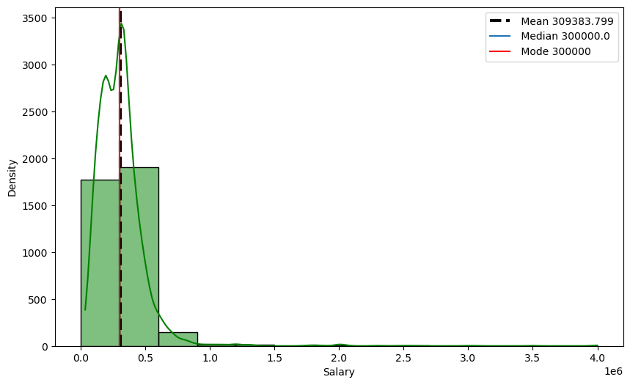
Univariate Analysis
Variable : Salary
Using this plot we can easily say that the average salary of the whole data lies in between 3.5 lakh to 4 lakhs
The measures of central tendency is approximately equal
This data exhibits a positive skewness

Slide 9
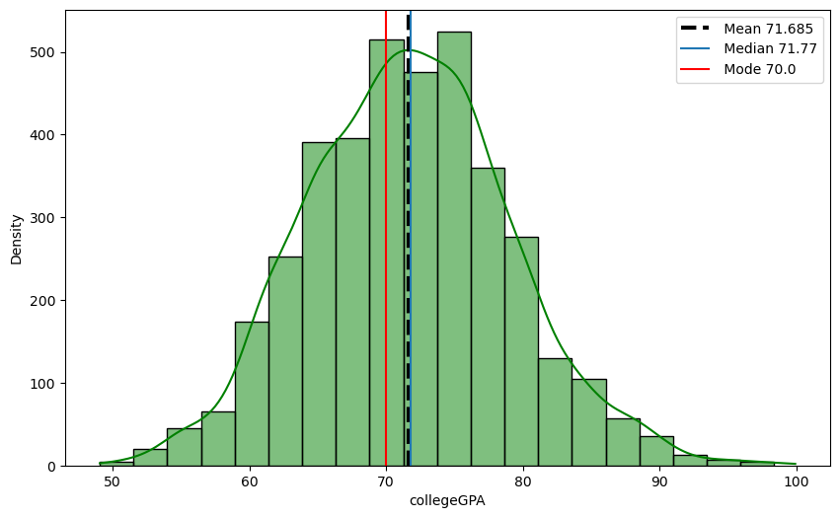
Univariate Analysis
Variable : College GPA
Using this plot we can easily say that the average GPA of Students is nearly 71.68
The measures of central tendency is approximately equal
In the whole College GPA data majority of students scored GPA between 70% to 80%

Slide 10
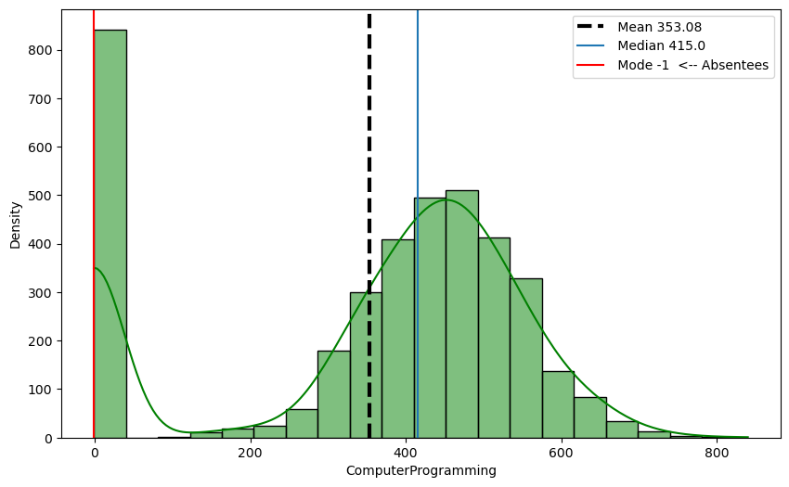
Univariate Analysis
Variable : Computer Programming
Using this plot we can easily say that the average Scores of students in AMCAT’s Computer programming exam is 353.08
Most of the students were absent or didn’t attended exam
In the whole Computer Programming scores data. Majority of students scores are between 300 to 450

Slide 11
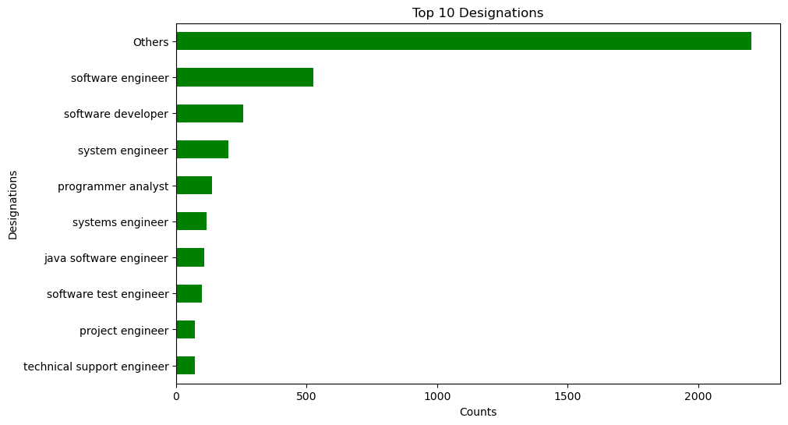
Univariate Analysis
Variable : Designation
Using this Graph we can easily say that the Top job designations mostly technology related
In the Whole designations data . We have around 415 unique job designations
The others bar resembles the overall unique job designations except the rest designations shown in the Graph

Slide 12
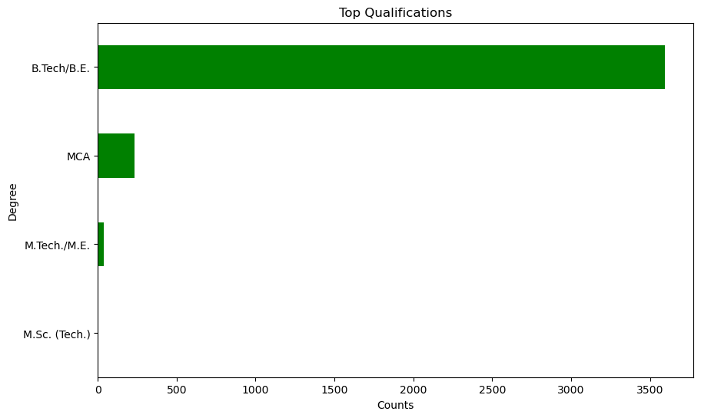
Univariate Analysis
Variable : Degree
Using this Graph we can easily say that the most of the students are from (B.Tech / B.E) Backgrounds. And it should be because data is scraped focusing on engineers.
M.Sc. Graduates are very negligible in this data.
The data surely represents that most of the students are getting job ready right after under graduation rather than proceeding forward to further studies.

Slide 13
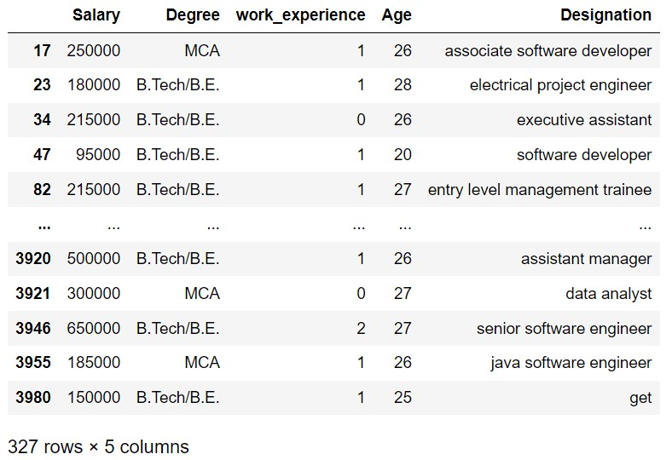
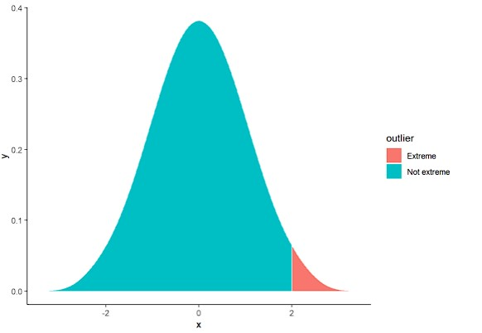
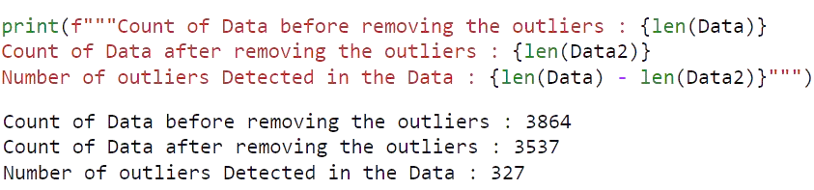
Outlier Detection

Slide 14
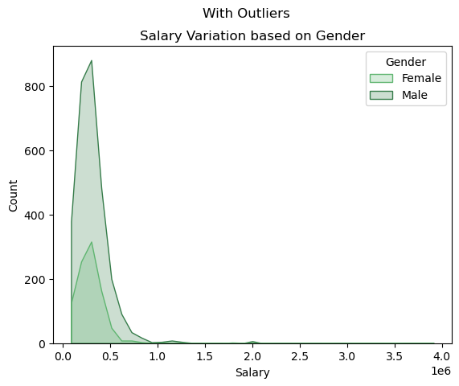
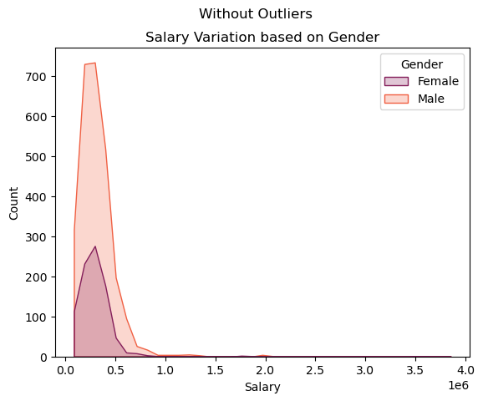
Bivariate Analysis
By the Graph it is evident that there is a salary variations based on Gender
For male pay scale is more compared to female

Slide 15
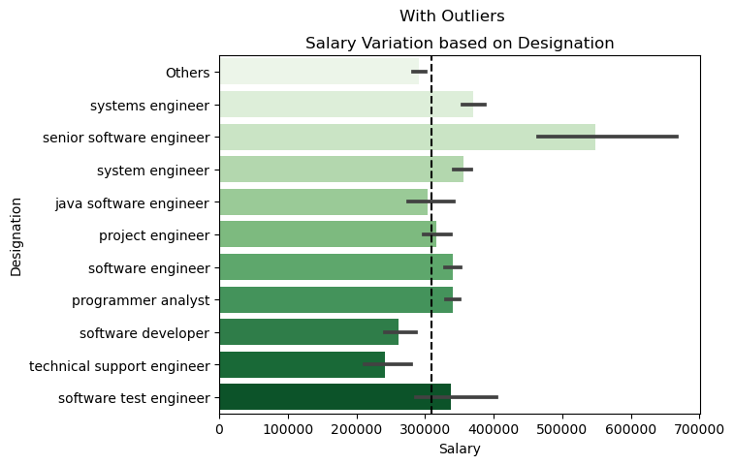
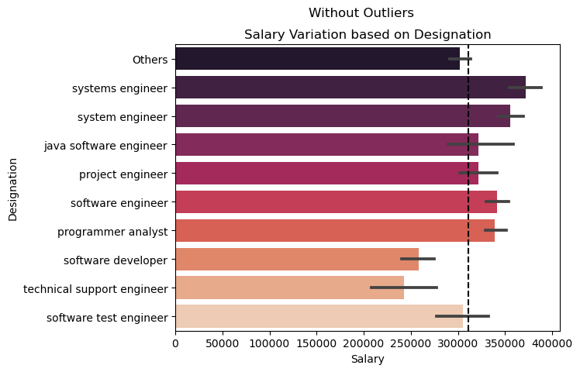
Bivariate Analysis
By the we can say that average pay scale of an engineer is 3,00,000 and maximum 4,00,000

Slide 16
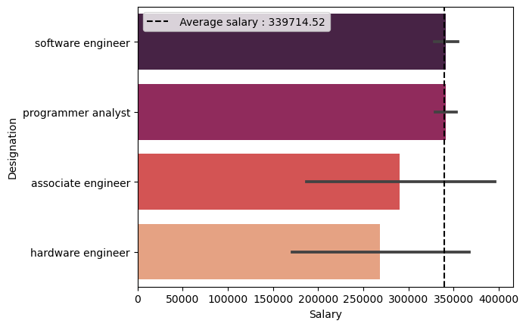
Bivariate Analysis
Research Question
Times of India article dated Jan 18, 2019 states that “After doing your Computer Science Engineering if you take up jobs as a Programming Analyst, Software Engineer, Hardware Engineer and Associate Engineer you can earn up to 2.5-3 lakhs as a fresh graduate.” Test this claim with the data given to you
The Statement made by Times of India is surely True. As shown in the Graph too it represents that average salary of jobs designations like Programming Analyst, Software Engineer, Hardware Engineer and Associate Engineers average salary is about 3 lakhs . “Hence Proved”

Slide 17
Conclusion
The comprehensive analysis of the AMEO data has yielded insightful answers to several key questions regarding post-graduation employment outcomes for engineering students. Among the notable findings are:
Gender-Based Compensation Disparities: The analysis reveals that there exists a slight bias in compensation based on gender. Specifically, male graduates tend to receive marginally higher salary offers compared to their female counterparts within similar roles and fields of study.
Impact of Field of Study on Salary: The analysis highlights significant variations in salary offers based on the specific field of study within engineering. Certain designations, such as Programming Analyst, Software Engineer, Hardware Engineer, and Associate Engineer, command higher salaries compared to roles such as Technical Support Engineer.
Influence of College Tier and Academic Performance: The findings indicate that the compensation offered to engineering graduates is influenced by factors such as the tier of the college they attended and their academic performance. Graduates from top-tier institutions tend to receive more lucrative salary offers compared to those from lower-ranked colleges.

Slide 18

THANK YOU

